Slide 1
T G.A VENTURES SALES DASHBOARD

Slide 2
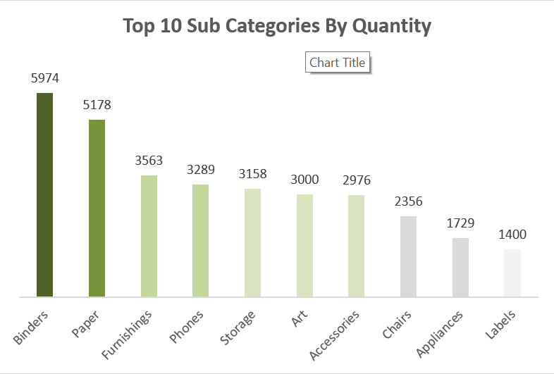
TOP 10 SUB-CATEGORIES BY QUANTITY
INSIGHT
The data shows high demand for office essentials like binders and paper, which lead in sales quantity. There's also notable interest in office infrastructure items like furnishings, phones, and storage, indicating a balance between consumable supplies and durable goods. The popularity of art and accessories suggests a trend toward workplace personalization. Lower sales for items like chairs and appliances reflect their durable nature. Labels, while niche, show steady demand for organizational tools. Overall, the business caters to a broad range of office needs, balancing everyday consumables with long-term investments.
RECOMMENDATION
My recommendation is to focus on maintaining strong inventory for high-demand consumables like binders and paper, while also exploring opportunities to boost margins in other categories, and re-strategize to increase their turnover.

Slide 3
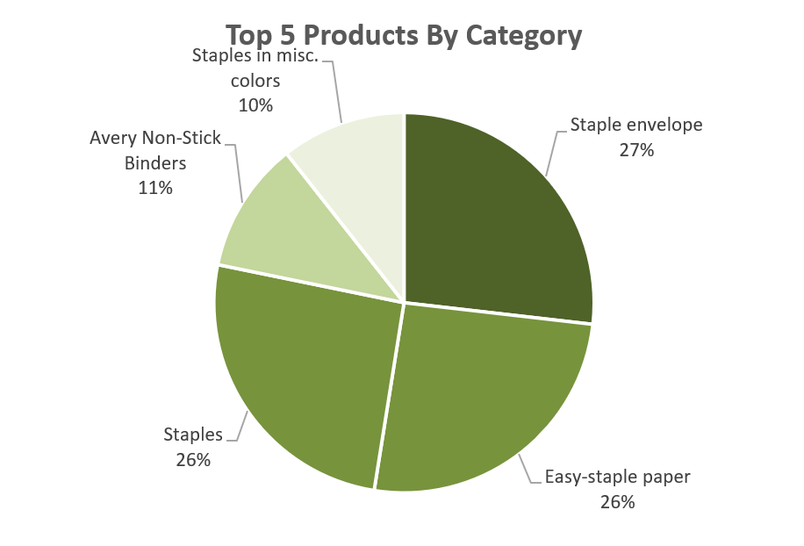
TOP 5 PRODUCTS BY CATEGORY
INSIGHT
The firm's revenue is heavily concentrated in its top three products—Staple Envelop, Easy Staple Paper, and Staple—which together account for 79% of the take. This suggests the firm is reliant on a few key products.
RECOMMENDATION
Focus on maintaining the strong performance of the top products while exploring ways to boost sales for lower-performing items that couldn’t make it to the Top 5. Diversifying product success can reduce risk and drive overall growth.

Slide 4
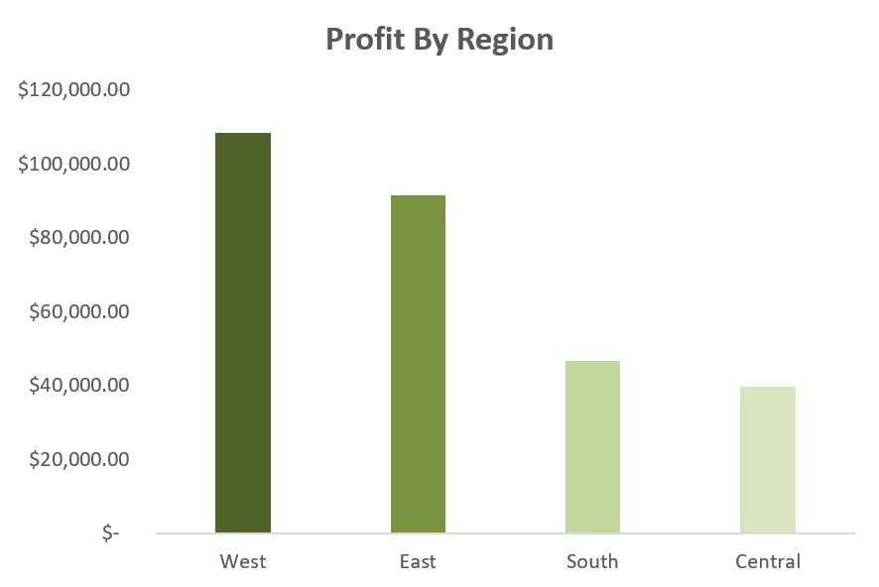
PROFIT BY REGION
INSIGHT
The firm's profits are concentrated in the West and East, with the West leading at $108,418 and the East generating $91,522. The South ($46,749) and Central ($39,706) regions lag behind, indicating potential challenges or untapped opportunities in these areas.
RECOMMENDATION
Prioritize maintaining and expanding the strong performance in the West and East regions. Investigate the South and Central regions to identify challenges or opportunities for growth, and implement strategies to boost profitability in these underperforming areas.

Slide 5
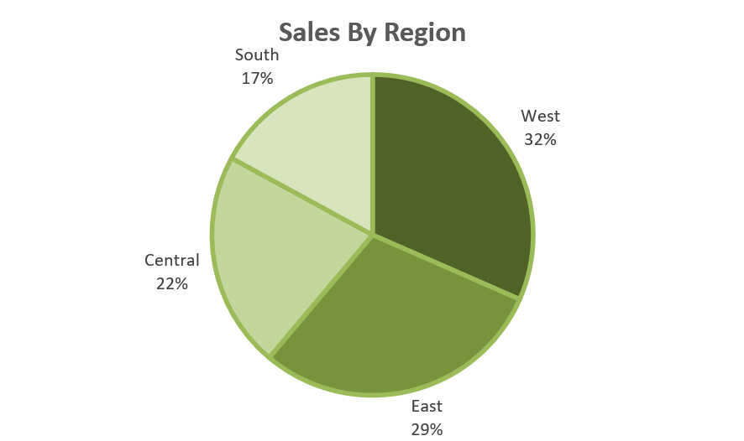
SALES BY REGION
INSIGHT
Sales are concentrated in the West (32%) and East (29%), making them the firm's strongest regions. The Central (22%) region has a moderate share, while the South (17%) is the weakest in terms of sales, indicating potential challenges in market penetration.
RECOMMENDATION
The sales distribution across regions shows that the West (32%) and East (29%) dominate the firm’s sales, contributing a combined total of 61%. This aligns with the earlier observation of high profits in these regions, indicating strong market presence and customer demand.

Slide 6
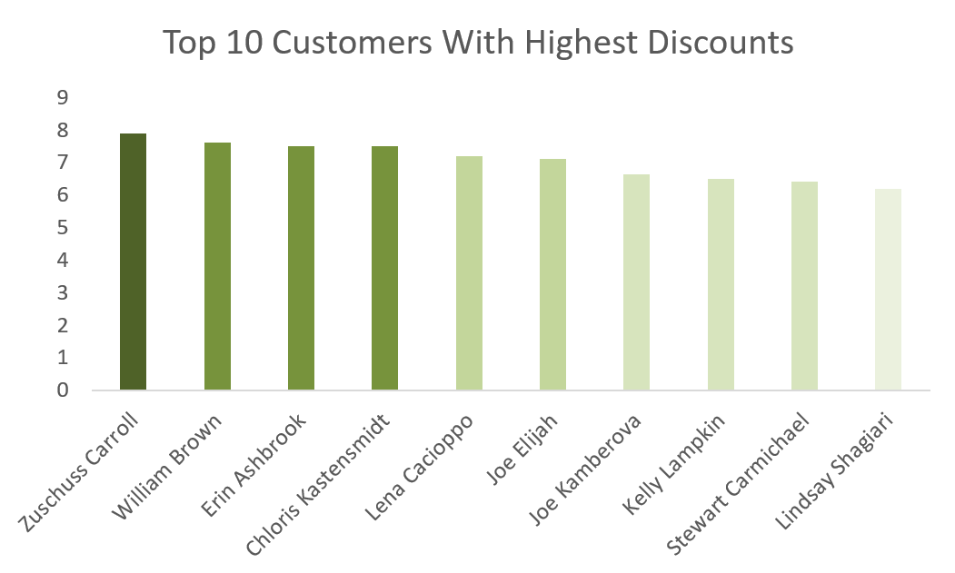
TOP 10 CUSTOMERS DISCOUNTS
INSIGHT
The top 10 customers receive high discounts, with the highest ranging from 7.9 to 6.2. While this discount strategy may help retain key customers, it could impact profitability.
RECOMMENDACTION
Evaluate the impact of high discounts on profitability and sales volume. Consider whether these discounts are justified by the returns in customer retention and revenue, and adjust discount strategies as needed to balance customer incentives with profitability.

Slide 7
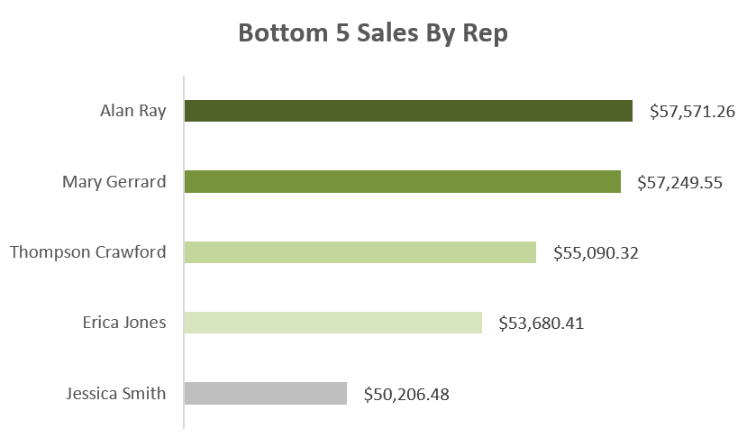
BOTTOM 5 SALES BY REP
INSIGHT
The bottom five sales representatives have relatively close sales figures, but Jessica Smith has the lowest performance at $50,206.
RECOMMENDATION
There are opportunities for improvement, particularly for everyone within this group. Analyze the sales strategies of the lower-performing representatives and provide targeted training or support to help improve their performance.

Slide 8
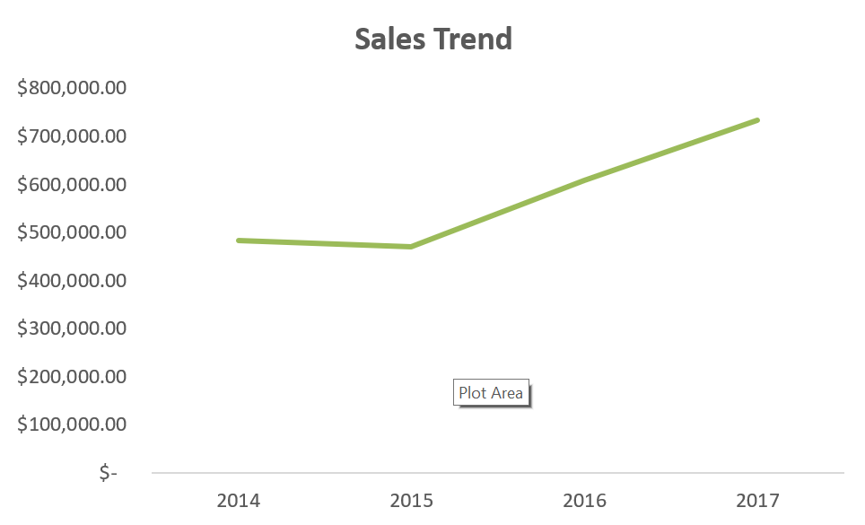
SALES TREND
INSIGHT
After a sales decline in 2015, the firm experienced strong growth in 2016 and 2017, with sales reaching their highest in 2017. The upward trend suggests effective strategies were implemented following 2015, leading to significant improvements.
RECOMMENDATION
Build on the successful strategies from 2016 and 2017 to sustain and further enhance growth. Analyze what contributed to the rebound and continued success, and apply those insights to maintain momentum and address any potential challenges.

Slide 9
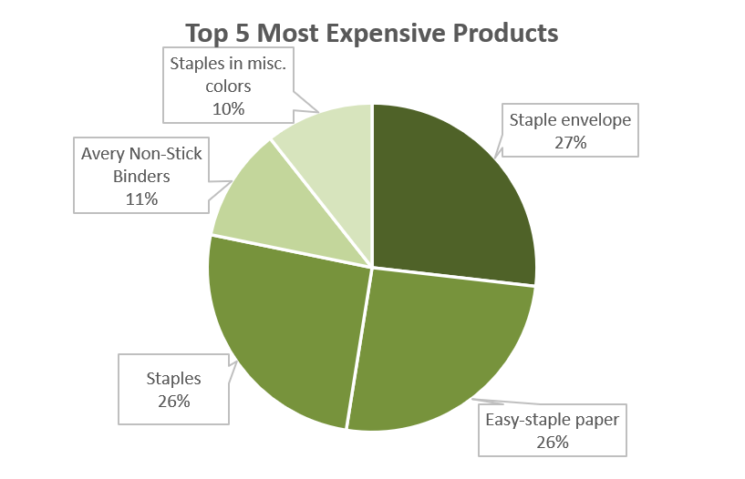
TOP 5 MOST EXPENSIVE PRODUCTS
INSIGHT
The top five most expensive products are dominated by Staple Envelop (27%) and Easy-Staple Paper and Staples (26% each). Avery Non-Stick Binders (11%) and Staples in Misc. Colors (10%) have smaller shares. Focusing on managing and optimizing the top products will be crucial for maximizing profitability.
RECOMMENDATION
Prioritize managing and optimizing the top three products (Staple Envelop, Easy-Staple Paper, and Staples) to maximize profitability. Also, consider strategies to improve the performance of the lower-share products (Avery Non-Stick Binders and Staples in Misc. Colors).

Slide 10
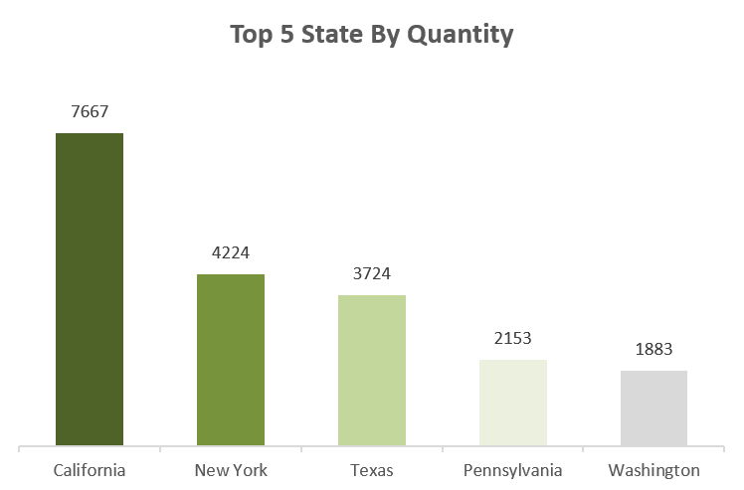
TOP 5 STATES BY QUANTITY
INSIGHT
California is the leading state in product sales by a large margin, followed by New York and Texas. Pennsylvania and Washington have smaller sales quantities.
RECOMMENDATION
Focus on expanding and optimizing sales strategies in California, and use insights from this top-performing state to boost sales in New York, Texas, Pennsylvania, and Washington.

Slide 11
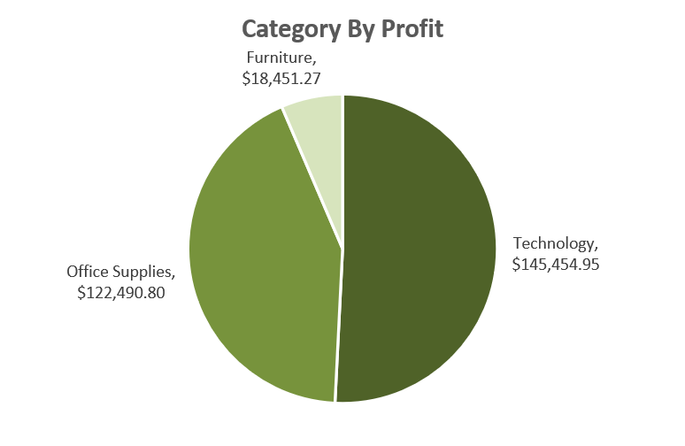
CATEGORY BY PROFIT
INSIGHT
Technology is the most profitable category, followed by Office Supplies. Furniture generates the least profit, suggesting it may face challenges or inefficiencies.
RECOMMENDATION
Prioritize expanding and optimizing the Technology and Office Supplies categories to maximize profitability. Also, address challenges in the Furniture category to improve its profit performance.

Slide 12
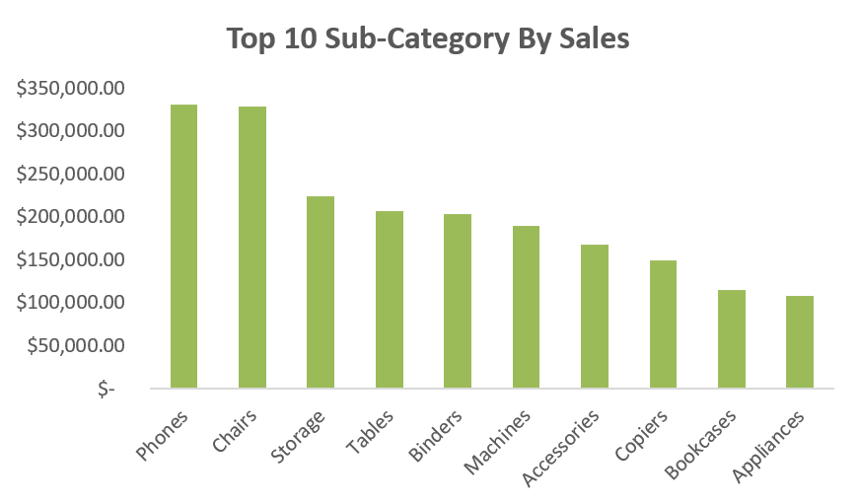
TOP 10 SUB-CATEGORIES BY SALES
INSIGHT
Phones and Chairs are the top-selling subcategories, significantly leading in sales compared to others.
RECOMMENDATION
Maintain and strengthen the performance of Phones and Chairs, while developing strategies to boost sales in the lower-performing subcategories.

Slide 13
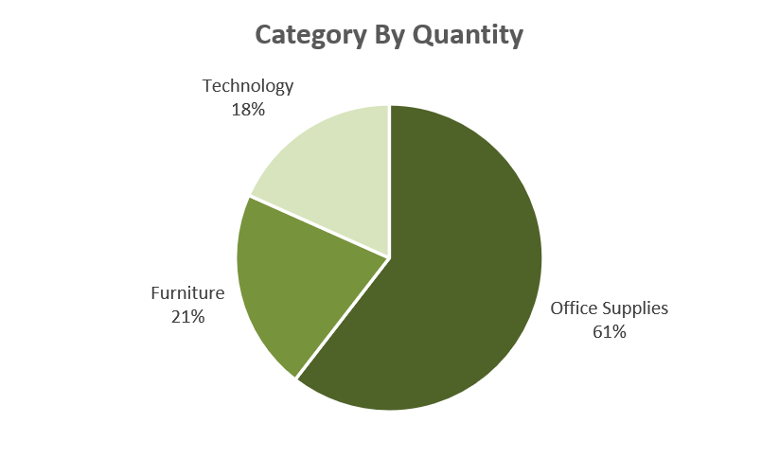
CATEGORY BY QUANTITY
INSIGHT
Office Supplies lead in sales volume with 61%, while Furniture accounts for 21% and Technology 18%. This indicates high demand for Office Supplies, with Furniture and Technology having smaller sales shares.
RECOMMENDATION
Focus on optimizing strategies for Office Supplies to maintain its strong sales volume. Additionally, develop initiatives to increase sales of Furniture and Technology to balance the overall sales distribution.

Slide 14
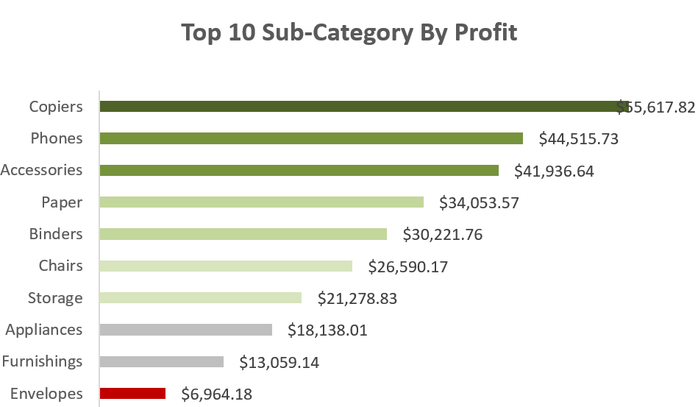
TOP 10 SUB-CATEGORY BY PROFIT
INSIGHT
Copiers, Phones, and Accessories are the top profit-generating subcategories. They significantly outperform others in profitability, while Envelopes, Furnishings, and Appliances contribute the least.
RECOMMMENDATION
Enhance the performance of the top profit-generating subcategories (Copiers, Phones, and Accessories) and seek ways to improve profitability in the lower-performing subcategories (Envelopes, Furnishings, and Appliances).

Slide 15
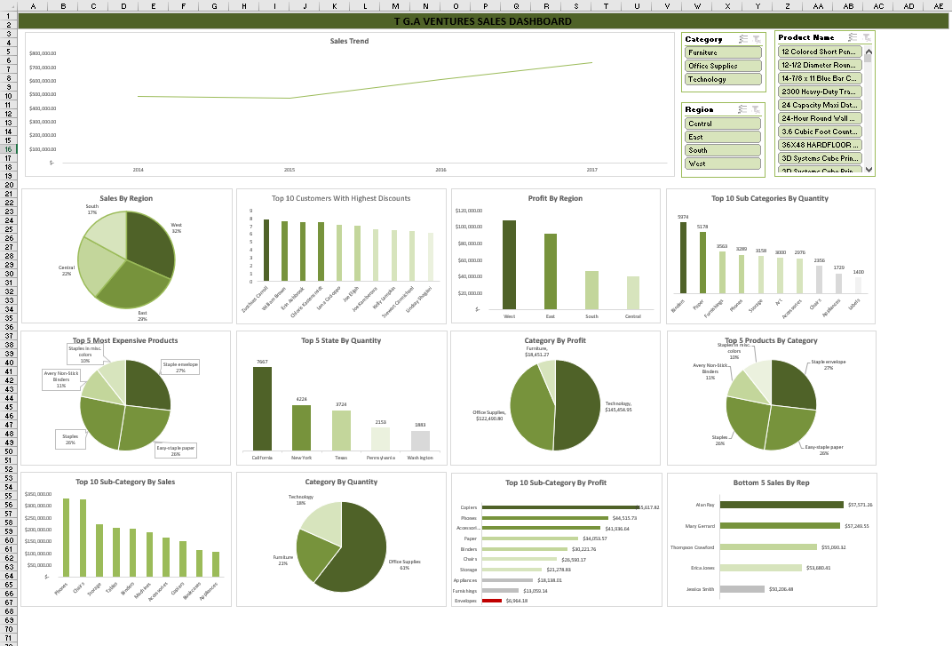
T G.A VENTURES SALES DASHBOARD
THIS IS A SALES DASHBOARD FOR T G.A VENTURE.

